Slide 1
Stress detection using Facial image recognition model and thermal camera
PRESENTED BY :-
PULLA NITHIN
SREERAM S
V VAMSI KRISHNA

Slide 2
OBJECTIVE :
Stress is a most common in students and working professionals as well . One in 8 Indians have serious trouble in dealing with stress and almost 75 percent of the Indian Victims said that they don’t feel comfortable talking to others or even with medical professionals about their stress . The Consultation cost was cited as one of the biggest barriers to seek professional help .
Hence ,we have developed this model by means of eyebrow detection , Eye Blink movement recognition , Emotion Recognition , Thermal Images , Binary Classification , Body Heat maps with the help of Convolutional Neural Network , Deep Learning , Machine Learning and Image Processing Techniques .

Slide 3
Methodology 1 :
Real Time facial Image Captured By the Camera
The Eye Aspect Ratio is found out , The shape Is Predicted and Analysed
The Stress/not Stress is Predicted and Stress Level is Displayed .
The Eyebrow detection and Emotion Recognition file is Run
The Displacement from mean, Contraction of both the eyes left and right is Calculated

Slide 4
METHODOLOGY 2:
Thermal Facial Image of the person is captured by an IR Thermal Camera .
The heat map is sent into a image processing function where the pixels matching the given colour scale determine the intensity function of the condition .
Accurate Results is Published .
Sent to Raspberry Pi Model and Django Framework .
Sent to a Convolutional Neural Network model built by TensorFlow for the mapping of the given heat map .

Slide 5

TensorFlow :-
TensorFlow is an Open Source and flexible Machine
Learning Software library developed by google brain .
TensorFlow offers multiple levels of abstraction we can train
models by using the high level Keras API .
It has more flexibility , Immediate Iteration and Intuitive Debugging .
The Major use of this library include classification , perception understanding , discovering, prediction and creation .

Slide 6
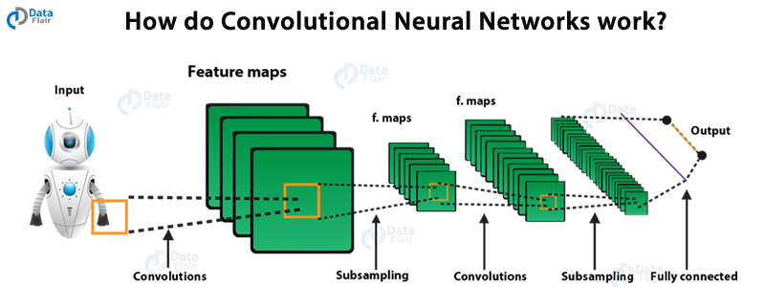
Convolutional Neural Network
Deep learning is a subfield of machine learning that is inspired by artificial neural networks .
A specific kind of such a deep neural network is the convolutional network, which is commonly referred to as CNN. It's a deep, feed-forward artificial neural network. Remember that feed-forward neural networks are also called multi-layer perceptron’s(MLPs), which are the quintessential deep learning models. The models are called "feed-forward" because information flows right through the model. There are no feedback connections in which outputs of the model are fed back into itself.

Slide 7
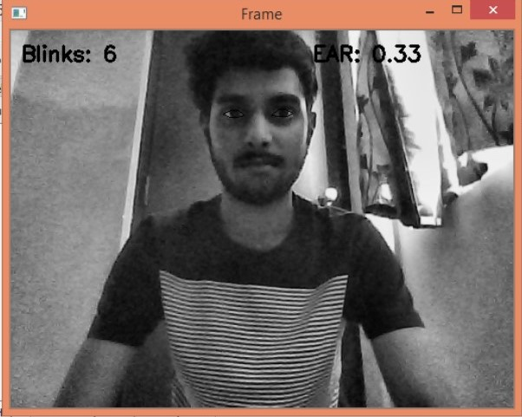
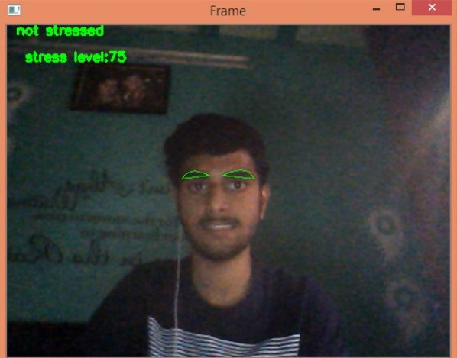
Results : Using Facial Recognition method
Input – Real Time Facial Image
Output – Stress Indication and Stress Level Displayed

Slide 8
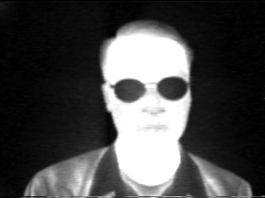
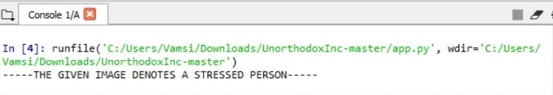
Results : Using Thermal Camera Method
INPUT – Thermal Image Of a Person
Output – The Person has Stress

Slide 9
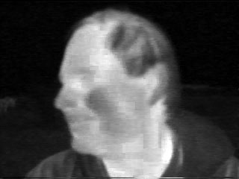
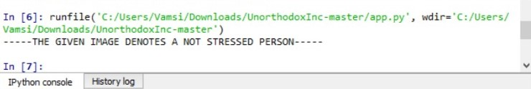
INPUT – Thermal Image of Another Person
Output - This Person Does Not Have Stress

Slide 10
CONCLUSION :
As we have seen earlier this project is mainly based in the objective of helping people aging between 18-35 to know their stress level and help them sought it out as the consultation cost was cited as one of the biggest barriers for people with this disease to seek the medical professionals help .
The Eyebrow movement model can be developed into a Web-Application and made available for everyone and make the process of stress detection easier .
Thermal Camera Method can be used an accurate analytical tool for the Psychiatrists , an essential tool that could be of support for the counsellors , caretakers , medical staff in schools , colleges and offices .
Our Main goal with this model is to reach out and help every youngster with the stress , anxiety and depression issues and make it easily accessible to each and every individual .

Slide 11
THANK YOU
DONE BY
SREERAM S
V VAMSI KRISHNA
PULLA NITHIN

